Slide 1

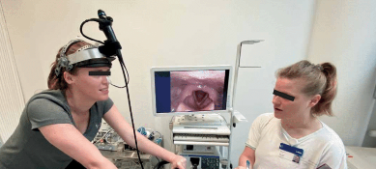
Automatic selection of suitable images from laryngoscopy videos
Final Project part A – 24-1-R-18
YOVEL COHEN - 209293059
EYAL KOUBI - 209291418
Supervisor: Dr. Elena Kleiman
27.5.2024

Slide 2
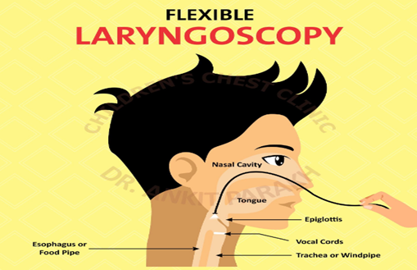
Problem Definition:
Current Diagnosis Challenges for LPR
LPR is caused by acid reflux reaching the throat, causing hoarseness and irritation without heartburn.
LPR diagnosis remains poorly defined.
Symptoms are varied and nonspecific.
Endoscopy relies on subjective assessments.
Patients' movements complicate image clarity.

Slide 3
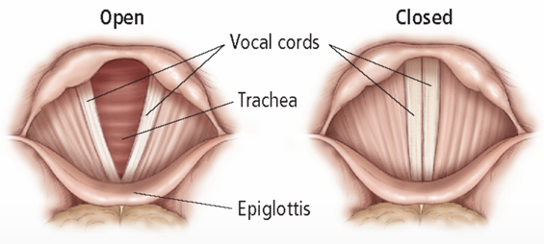
Problem Definition:
Necessity for an Advanced Diagnostic Tool
Existing methods insufficient for reliable diagnosis.
Need for objective, precise diagnostic tools.
Automated image analysis can enhance accuracy.
Selects most suitable frames automatically.
Supports diagnosis with relevant areas selection.

Slide 4
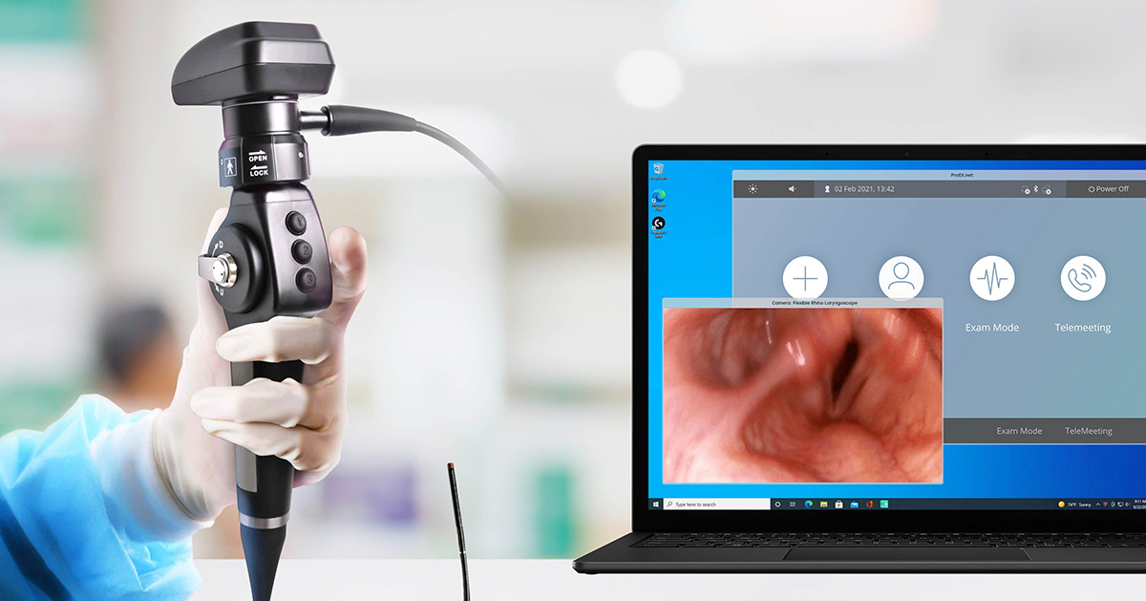
Our Solution
Automated Frame Selection
Software selects high-quality frames from videos.
Uses various image processing techniques.
Enhances objectivity and precision in diagnosis.
Interface convenient for medical professionals.

Slide 5
Our Solution flow
Begin analysis with endoscopy test video.
Convert each frame in video to grayscale from RGB.
Calculate histogram and apply Otsu's method for threshold.
Calculate motion vector for current and next frame.
Detect 'V' shape in regions, add frame to analysis list if present.
Segment the frame Using Area Growing to identify regions.
Add next frame to analysis list if motion vector is consistent.
Crop each frame to focus on the sides and base of the triangle. Apply focus functions.
Select top three frames based on focus quality in base, sides, and overall aspect of larynx.

Slide 6
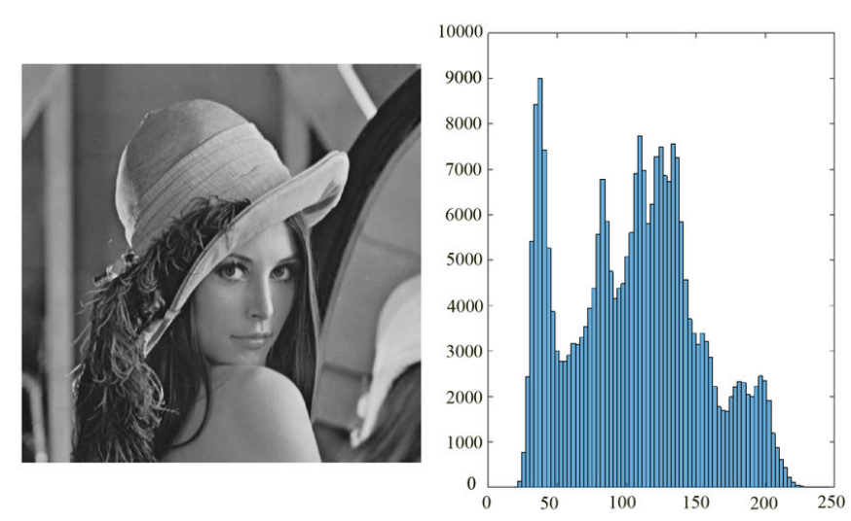
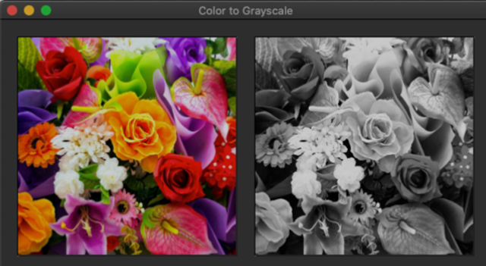
Algorithm steps
Histogram Creation and Otsu's Thresholding
Histogram Creation
Converts video frames to grayscale: Focuses on light intensity.
Creates histograms for each frame:
X-axis: Intensity values from 0 (black) to 255 (white).
Y-axis: Frequency of each intensity level.
Otsu's Thresholding
Finds optimal threshold to separate foreground from background.
Uses histogram data to maximize contrast between key image areas.

Slide 7
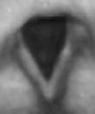
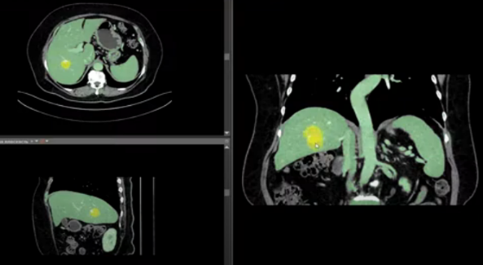
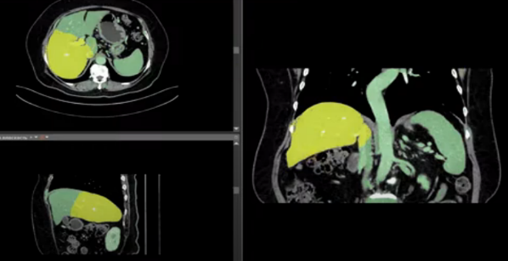
Algorithm steps
Region Segmentation Using Area Growing
Purpose: Precisely segment the larynx region from laryngoscopic images.
Challenges: Suppose to address inconsistencies in lighting.
Starting Point: Begins with the darkest pixel as the initial seed for growth.
Expansion Strategy: Expands the region by incorporating adjacent pixels if they fall below the Otsu threshold or within a set tolerance for light variation.
Iteration Process: Continuously searches for new seeds to ensure appropriate clustering.

Slide 8
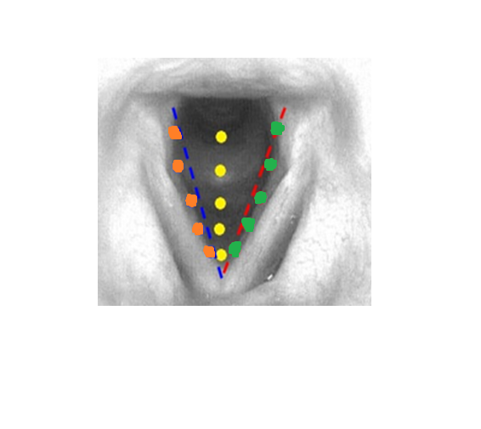
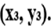
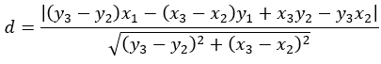
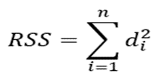
Algorithm steps
Triangle Detection
Purpose: Identify V-shaped structure in the larynx.
Importance: Check if frame contains relevant area.
Detection Method: Uses least squares fitting for accuracy.
Point Selection: Chooses extremes points on the edges of cluster
(base, up-right ,up-left ).
Distance Calculation: Measures perpendicular distances to triangle sides.
Evaluation: Uses sum of squared residuals (RSS) for fit assessment.

Slide 9
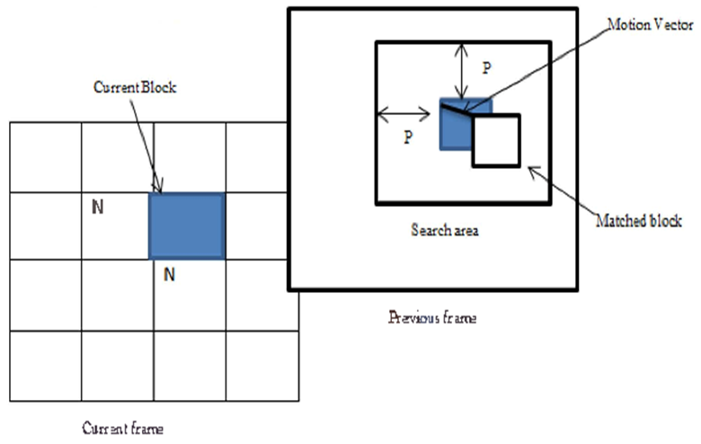
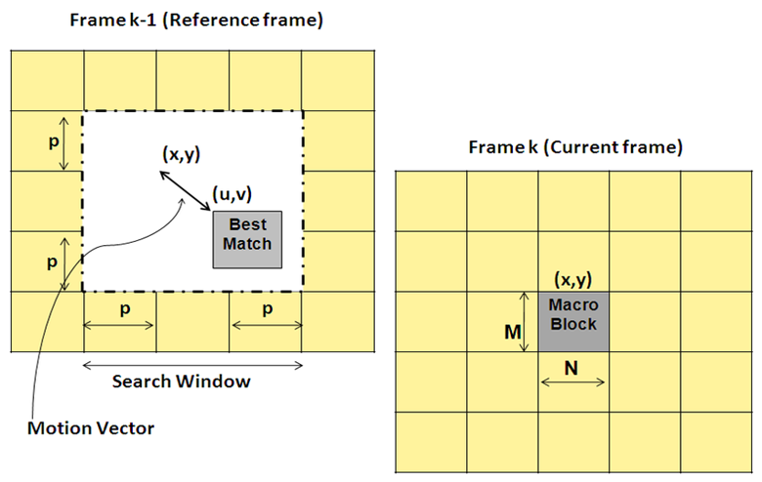
Algorithm steps
Block Matching for Frame Detection
Purpose: Verify V-shaped structure across frames for quality and consistency.
Approach: Focus on the triangle’s boundary, reducing computational load.
Matching Blocks: Identify closest matching boundary blocks in consecutive frames.
Motion Vectors: Calculate displacement vectors to understand movement dynamics.
Consistency Check: Assess motion vector consistency to validate frame quality.

Slide 10
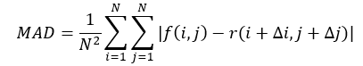
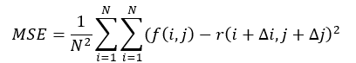
Algorithm steps
Block Matching for Frame Detection
Cost Functions: Search Parameters: Limit search range with parameter P to speed up matching.
Use MAD and MSE to determine the best match:
MAD: Average absolute pixel difference for rapid similarity assessment.
MSE: Squared pixel differences, emphasizing larger discrepancies for accuracy.
f(i,j) - The brightness of a pixel in the current block.
N - The size of the block (width and height in pixels).
r(i+∆i,j+∆j) - The brightness of a pixel in the reference block, offset by (∆i,∆j) to account for motion.

Slide 11
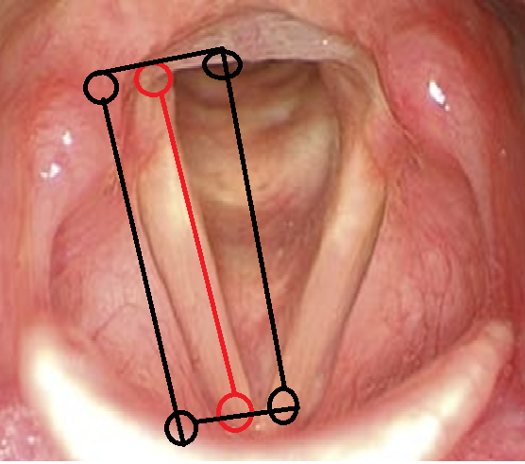
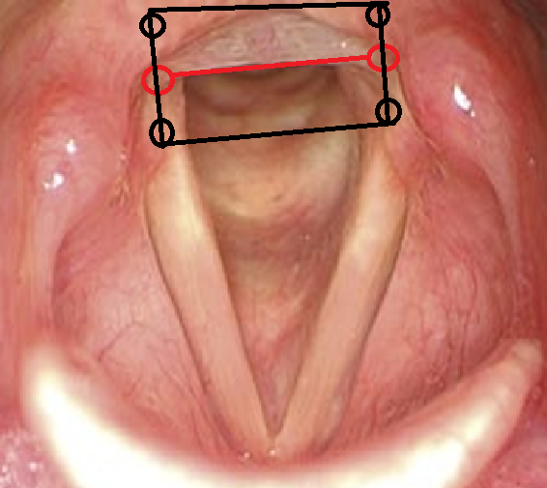
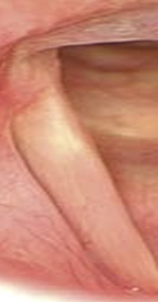
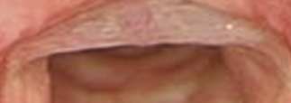
Algorithm steps
Frame Analysis for Optimal Focus Detection
Purpose: Identify the sharpest and most focused frames for detailed anatomical analysis in laryngoscopy video.
Isolate 'sides' and 'base' of larynx for focused evaluation.
Frame Segmentation:
General Frame: Assess overall focus.
Sides Segmentation: Select vocal folds.
Base Segmentation: Select subglottic area.

Slide 12
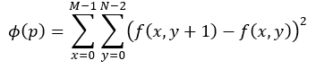
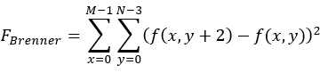
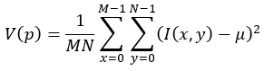
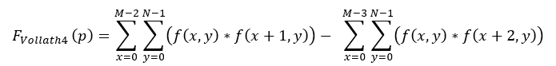
Algorithm steps
Frame Analysis for Optimal Focus Detection
Focus Measurement:
Squared Gradient Brenner's Gradient
Variance of Intensities Vollath’s F4 Autocorrelation
• f (x, y)/ I(x,y) - This represents the intensity of the pixel located at coordinates (x,y).
• M - This is the number of rows in the image , N - This is the number of columns.
• μ represents the mean intensity of all pixels in the image.

Slide 13
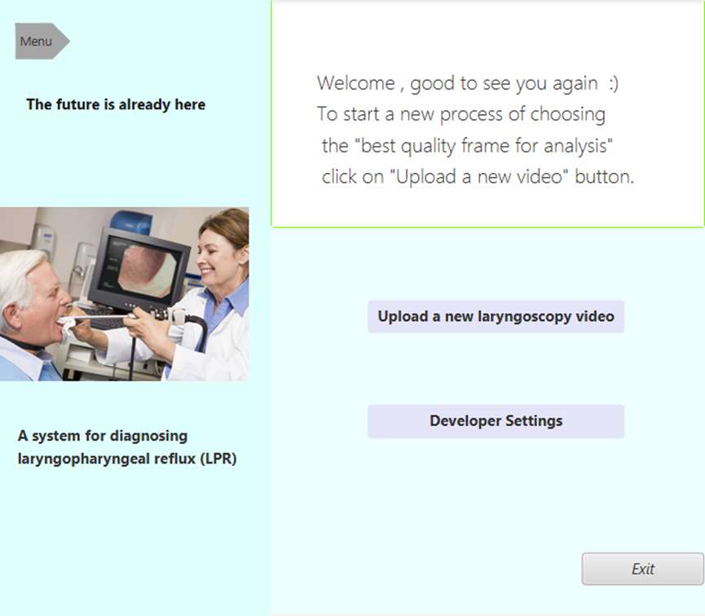
Product Diagram and GUI
Main Screen
Features two main interface elements.
"Upload new laryngoscopy video" button for all.
Allows video file uploads into the system.
"Developer Settings" button for developers.
Enables adjustment of system parameters.

Slide 14
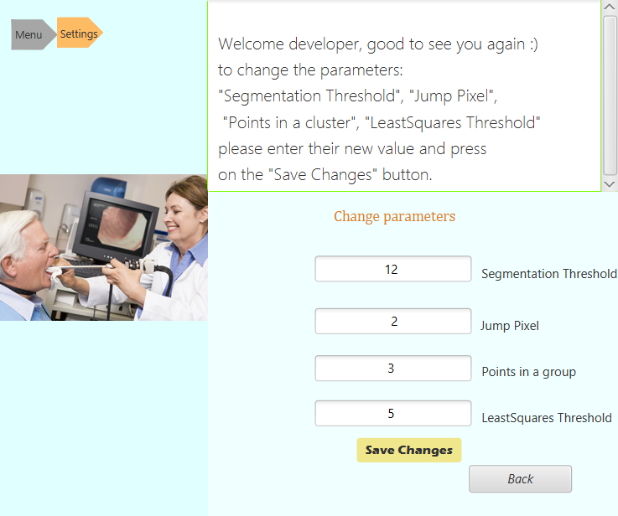
Product Diagram and GUI
Developer Settings Screen
Exclusive for developers.
Modify critical parameters.
Update via Save Changes button.
Back button for easy navigation.
Ensures system’s customizability.

Slide 15
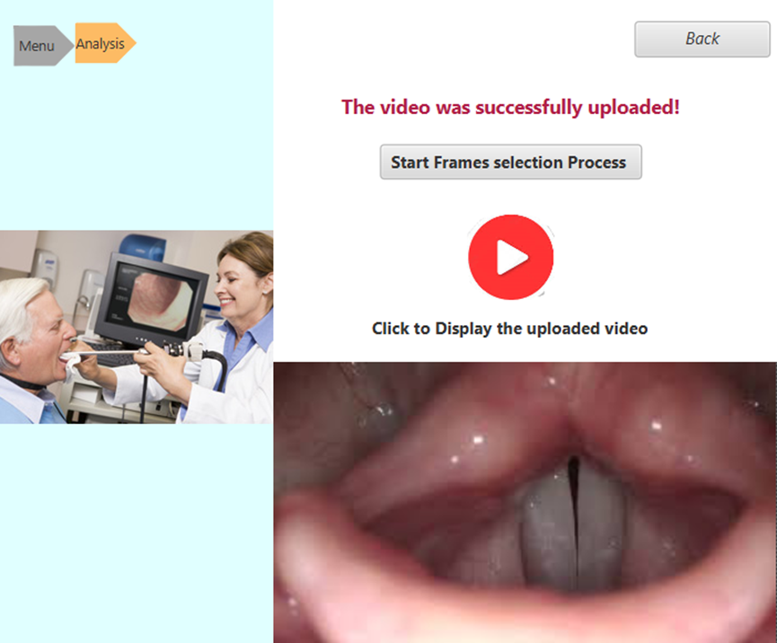
Product Diagram and GUI
Video Analysis Screen
Confirms successful upload.
Starts frame selection process.
Review video before analysis.
Back button for navigation.

Slide 16
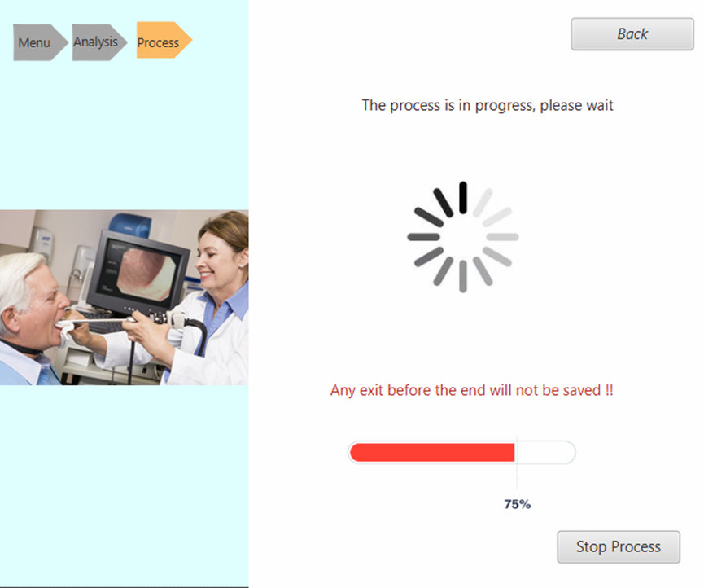
Product Diagram and GUI
Process Screen
Displays active process status.
Visual: Loading animation.
Progress bar shows completion.
Warning: Exiting will not save changes.
Abort option: Stop process.

Slide 17
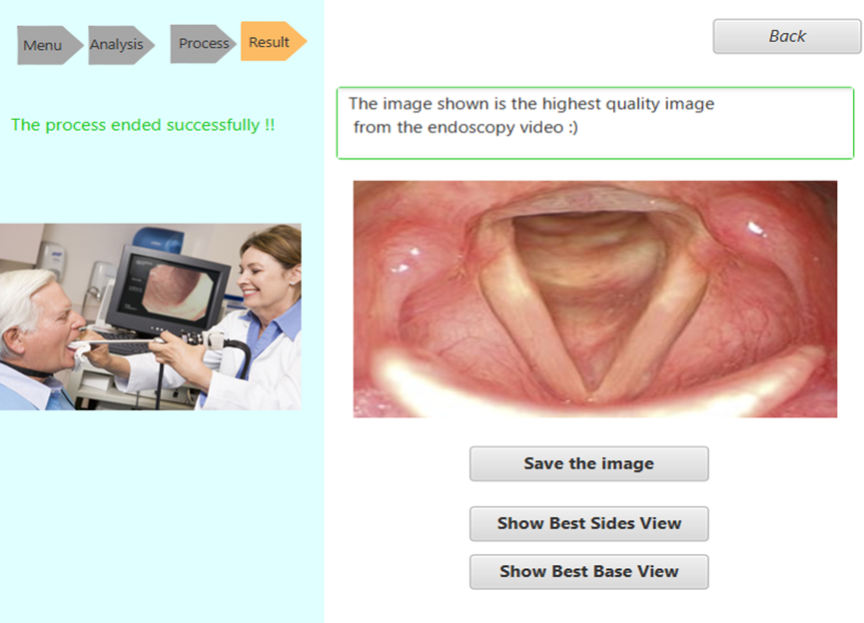
Product Diagram and GUI
Result Screen
Confirms successful process.
Shows highest quality V-shaped image.
Buttons to view sides and base.
Allows saving of optimal image.

Slide 18
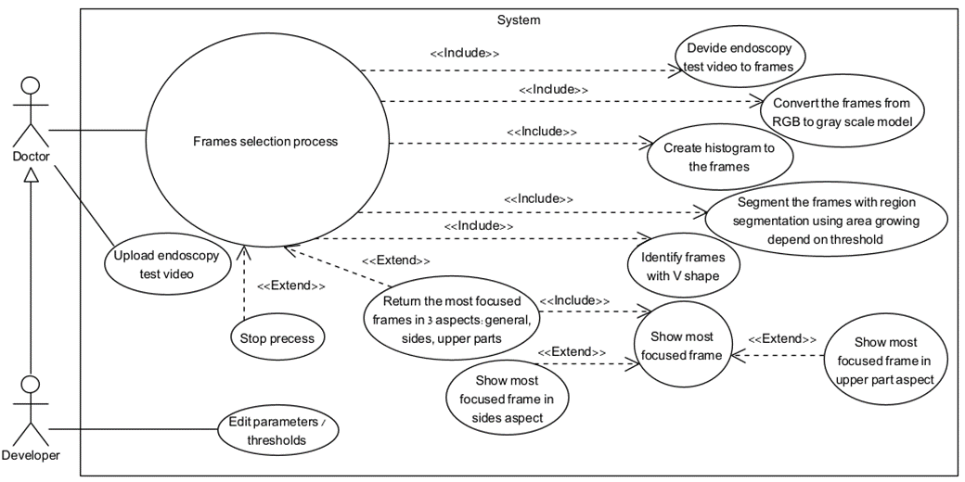
Product Diagram and GUI
Use Case Diagram

Slide 19
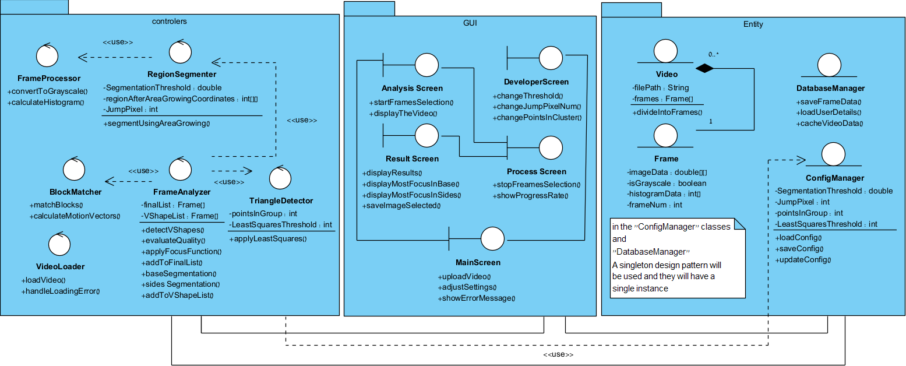
Product Diagram and GUI
Class Diagram

Slide 20
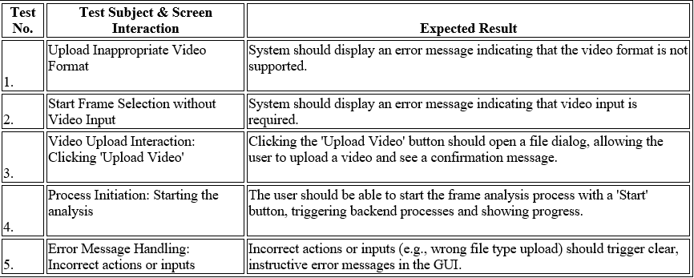
Evaluation / Verification Plan
GUI Testing

Slide 21
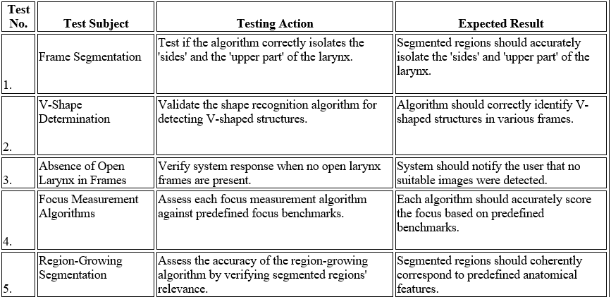
Evaluation / Verification Plan
Functional Testing

Slide 22
Expected Goals
Develop optimal frame selection algorithm.
Enhance diagnostics with decision-support tools.
Tailor image processing to laryngoscopy needs.
Establish robust test plans for validation.
Improve patients’ care through precise diagnostics.

Slide 23
Expected Challenges
Overcome data scarcity.
Ensure algorithm stability across variable videos.
Adapt image processing to detect V-shape consistently.
Working with real patients’ laryngoscopic videos.

Slide 24
Thank you for listening

